Slide 1
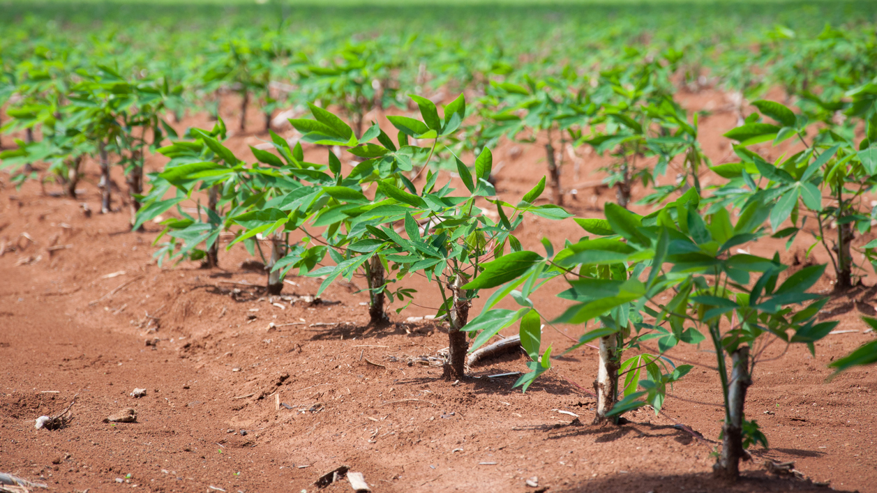
Identify Type of Disease from Image of Cassava Leaves with Deep Learning Methods
Hanlin Tang, Yuechuan Chen, Hua Tong
This Photo by Unknown Author is licensed under CC BY-NC-ND

Slide 2
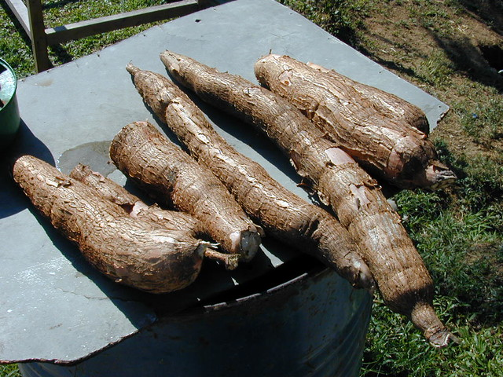
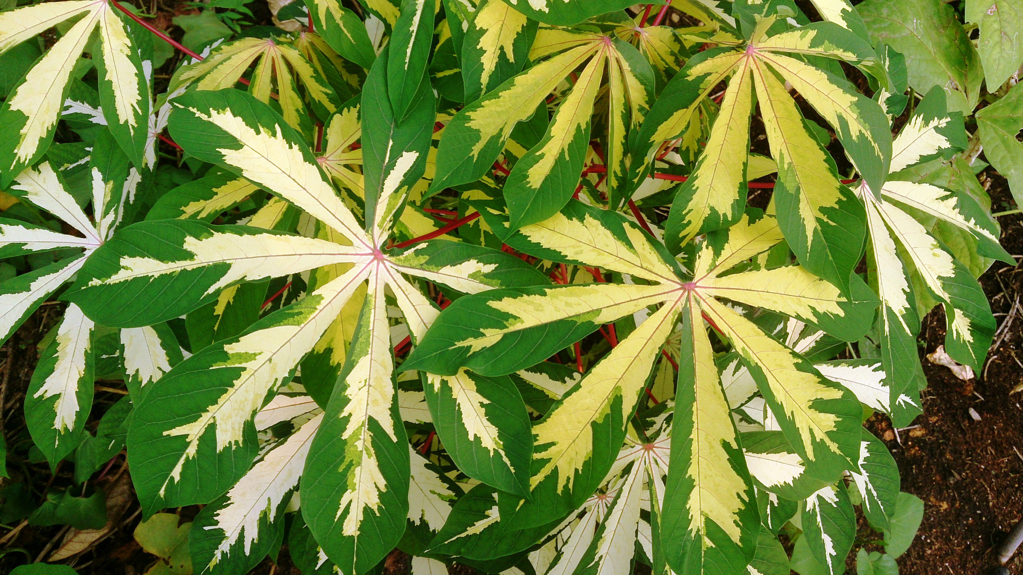
Contents
Background and Motivation
Methods and Models
Experiment Details
Result and Conclusion

Slide 3
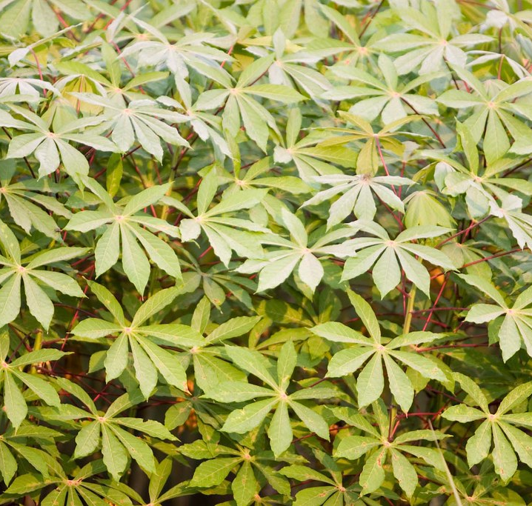
Background and Motivation

Slide 4
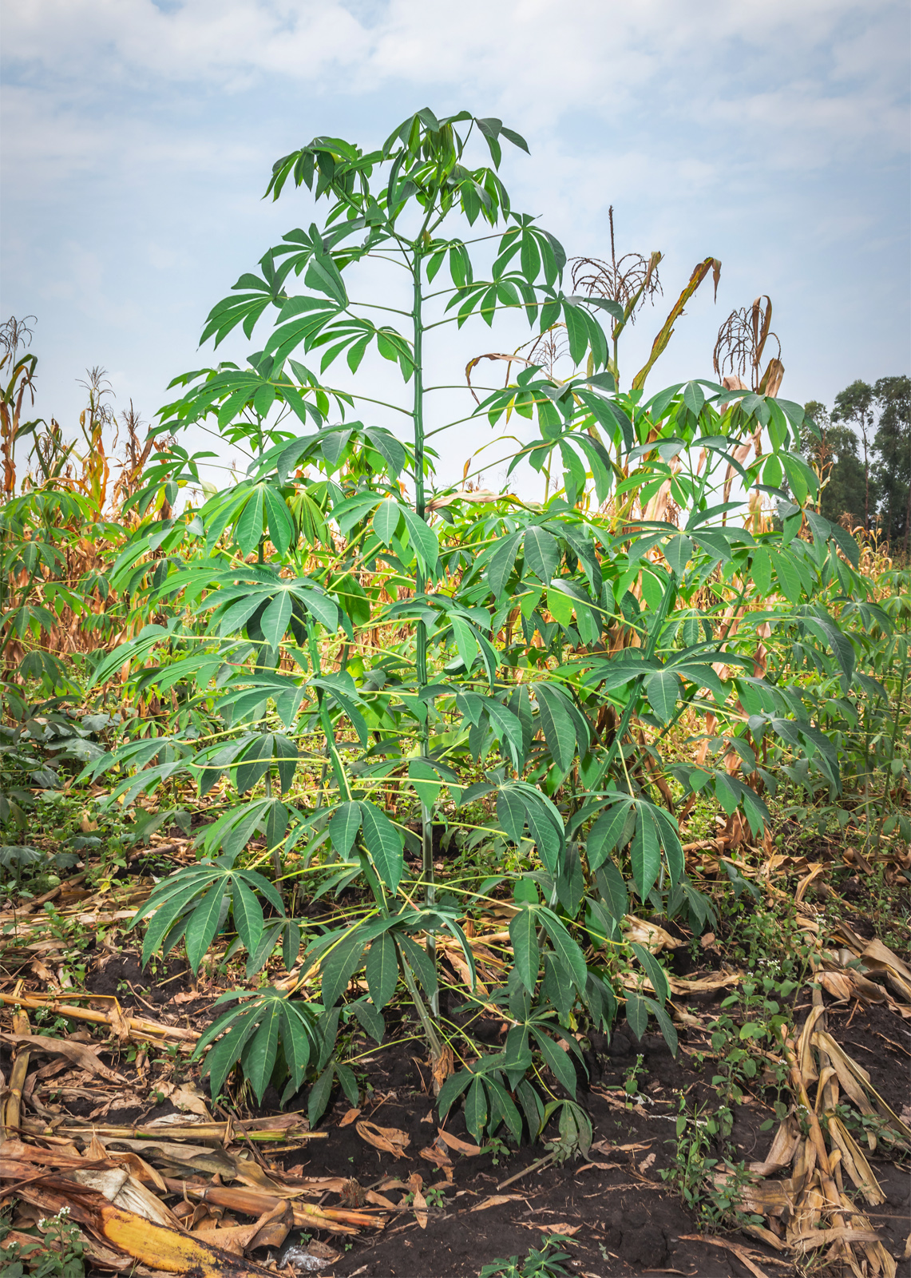
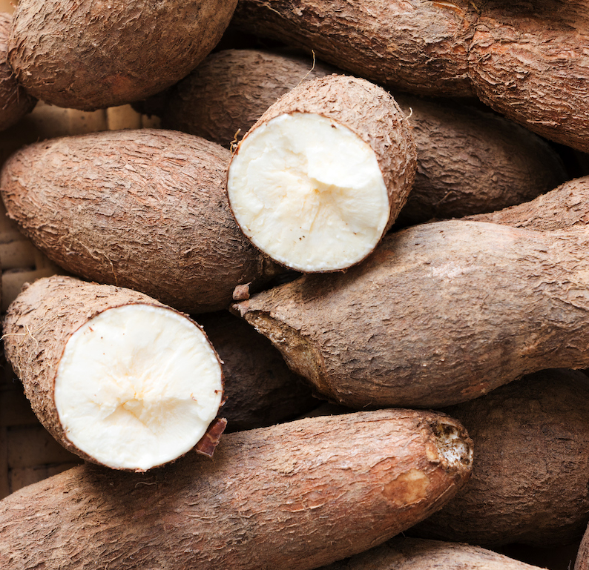
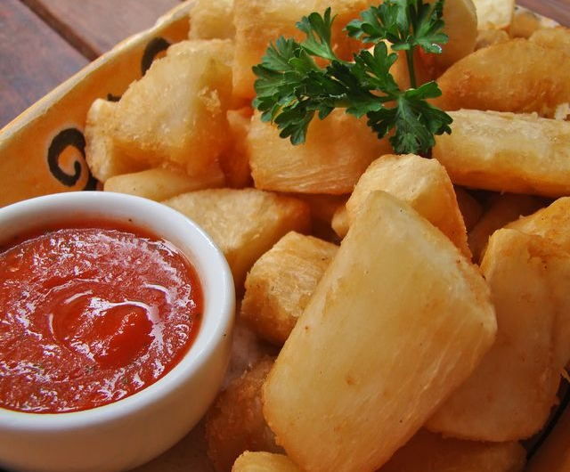
Background
Cassava, a major staple food in the developing world that plays a vital role in saving the world from hunger.
At least 80% of household farms in Sub-Saharan Africa grow it.
However, there are viral diseases that preventing good yields.

Slide 5
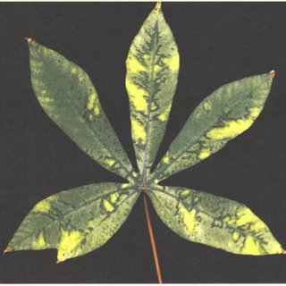
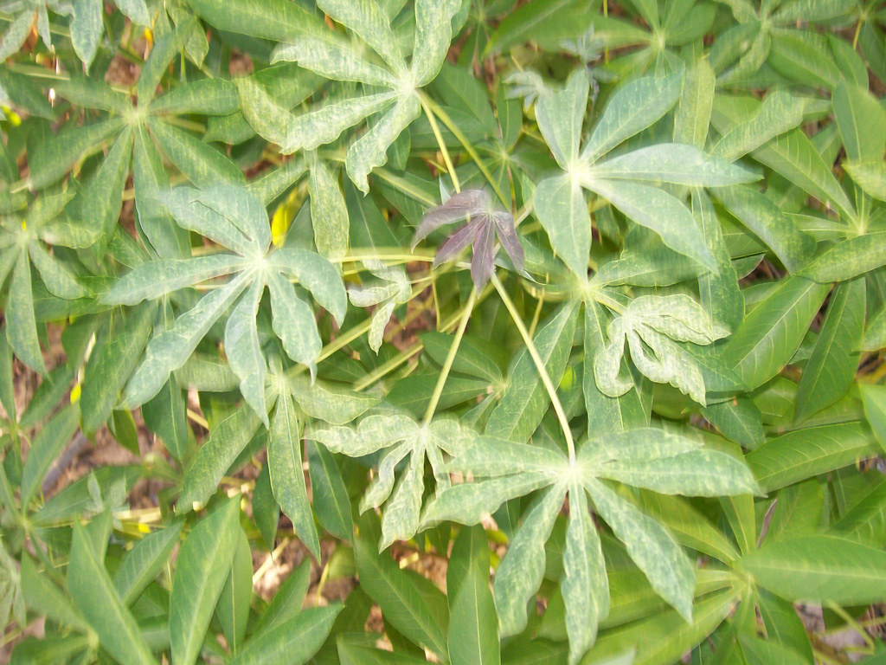
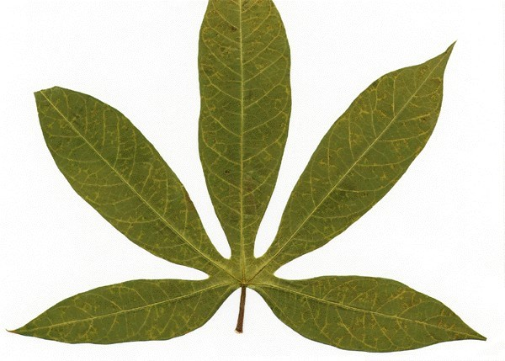
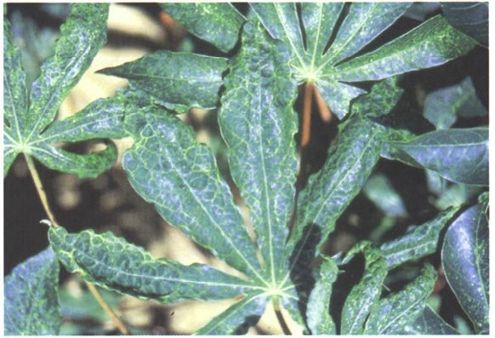
Diseases
Cassava Bacterial Blight (CBB)
Cassava Brown Streak Disease (CBSD)
Cassava Green Mottle (CGM)
Cassava Mosaic Disease (CMD)

Slide 6
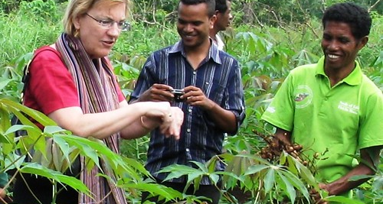
Motivation
Existing detection methods require the involvement of experts’ inspection, which suffers from being labor-intensive, costly, and sometime inaccessible.
Meanwhile, find out the infected plants sooner could help stopping it from spreading.
Thus, “identifying disease with image” comes to be an option.

Slide 7
Methods and Models
This Photo by Unknown Author is licensed under CC BY

Slide 8
Experiment Details
This Photo by Unknown Author is licensed under CC BY

Slide 9
Result and Conclusion
This Photo by Unknown Author is licensed under CC BY

Slide 10

Diseases

Slide 11
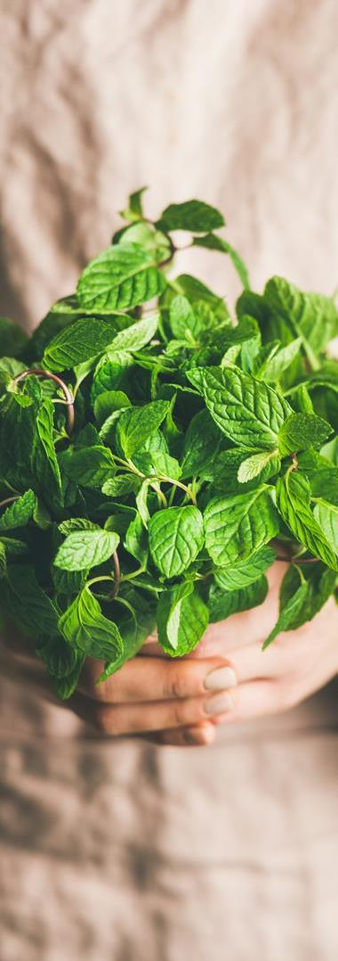

Table
 | Category 1 | Category 2 | Category 3 | Category 4
Item 1 | 4.5 | 2.3 | 1.7 | 5
Item 2 | 3.2 | 5.1 | 4.4 | 3
Item 3 | 2.1 | 1.7 | 2.5 | 2.8
Item 4 | 4.5 | 2.2 | 1.7 | 7

Slide 12
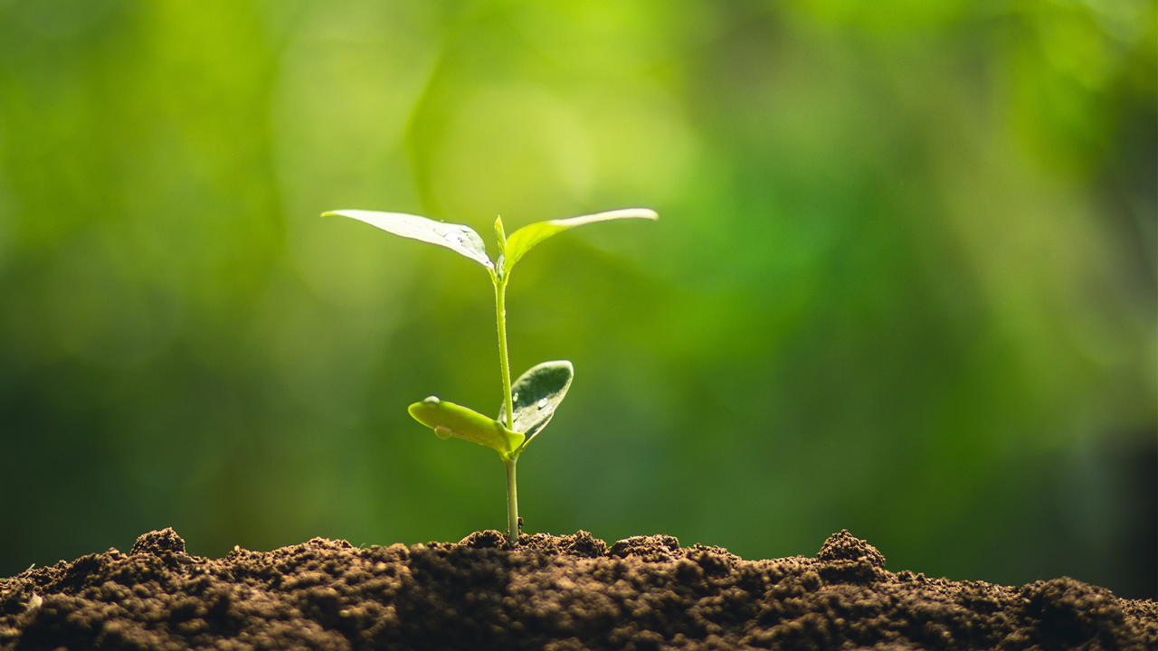
The way to get started is to quit talking and begin doing.
Walt Disney

Slide 13
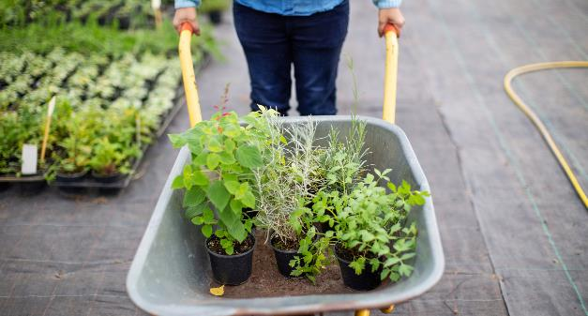
Two Content
Subtitle
Subtitle
Add text, images, art, and videos.
Add transitions, animations, and motion.
Save to OneDrive, to get to your presentations from your computer, tablet, or phone.
Open the Design Ideas pane for instant slide makeovers.
When we have design ideas, we’ll show them to you right there.

Slide 14
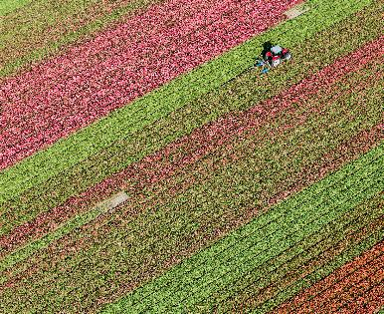
Three Content
Subtitle
Subtitle
Subtitle
Add text, images, art, and videos.
Add transitions, animations, and motion.
Save to OneDrive, to get to your presentations from your computer, tablet, or phone.
Open the Design Ideas pane for instant slide makeovers.
When we have design ideas, we’ll show them to you right there.
This PowerPoint theme uses its own unique set of colors, fonts, and effects to create the overall look and feel of these slides.
PowerPoint has tons of themes to give your presentation just the right personality.

Slide 15
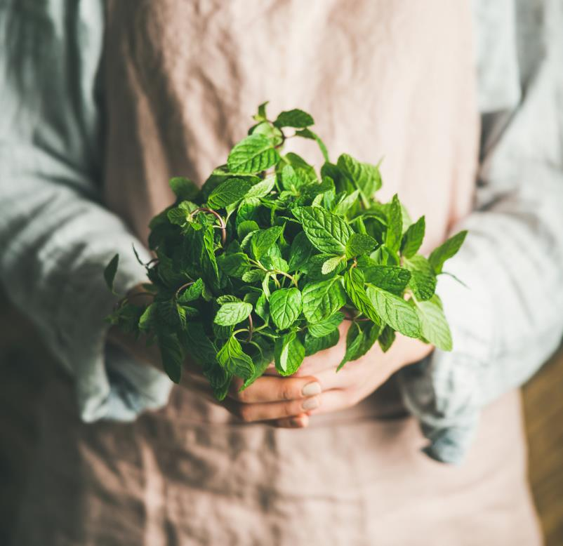
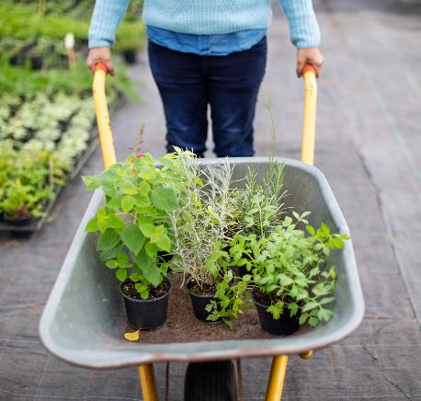
Conclusion
We practiced our skills in deep learning and meet the target we set at the beginning of the project.
We also learned the complexity of tuning and how cost it could be to run deep learning training.
The final result, though not outstanding, is pretty usable.

Slide 16
Thank You
Hanlin Tang, htang79@wisc.edu
Yuechuan Chen, ychen959@wisc.edu
Hua Tong, htong24@wisc.edu
Github: https://github.com/Tonghua35/453-Final-Project

